Slide 1
The Drive System
They see me rollin’

Slide 2
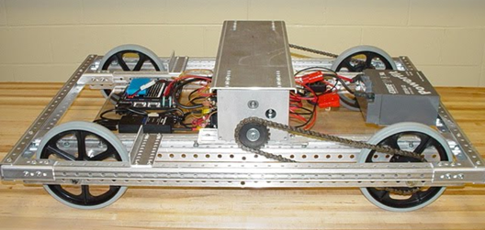
Hey MJ, what’s a Drive System?
The wheels, the motors, the gearboxes, the chassis, and what makes the robot go.
Every FIRST robot has wheels.*
Possibilities are endless!

Slide 3
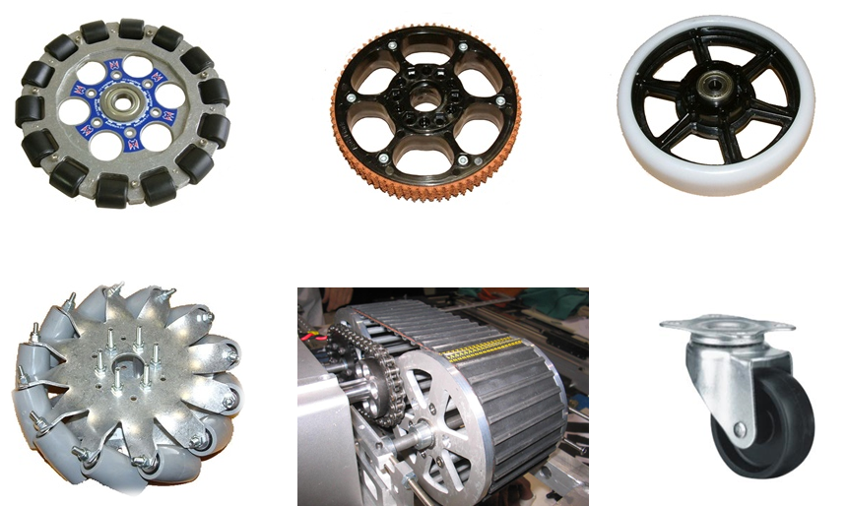
(Rock and) Roll
The Wheel!
Contrary to popular belief, it’s been reinvented many times. To name a few incarnations:
Omni
Mecanum
High Traction
Slippy
Treads
“those shopping cart things”
Must choose best wheel for task; each one has its benefits and drawbacks.
How many wheels?
Which are powered?

Slide 4
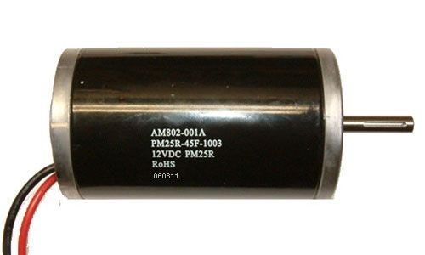
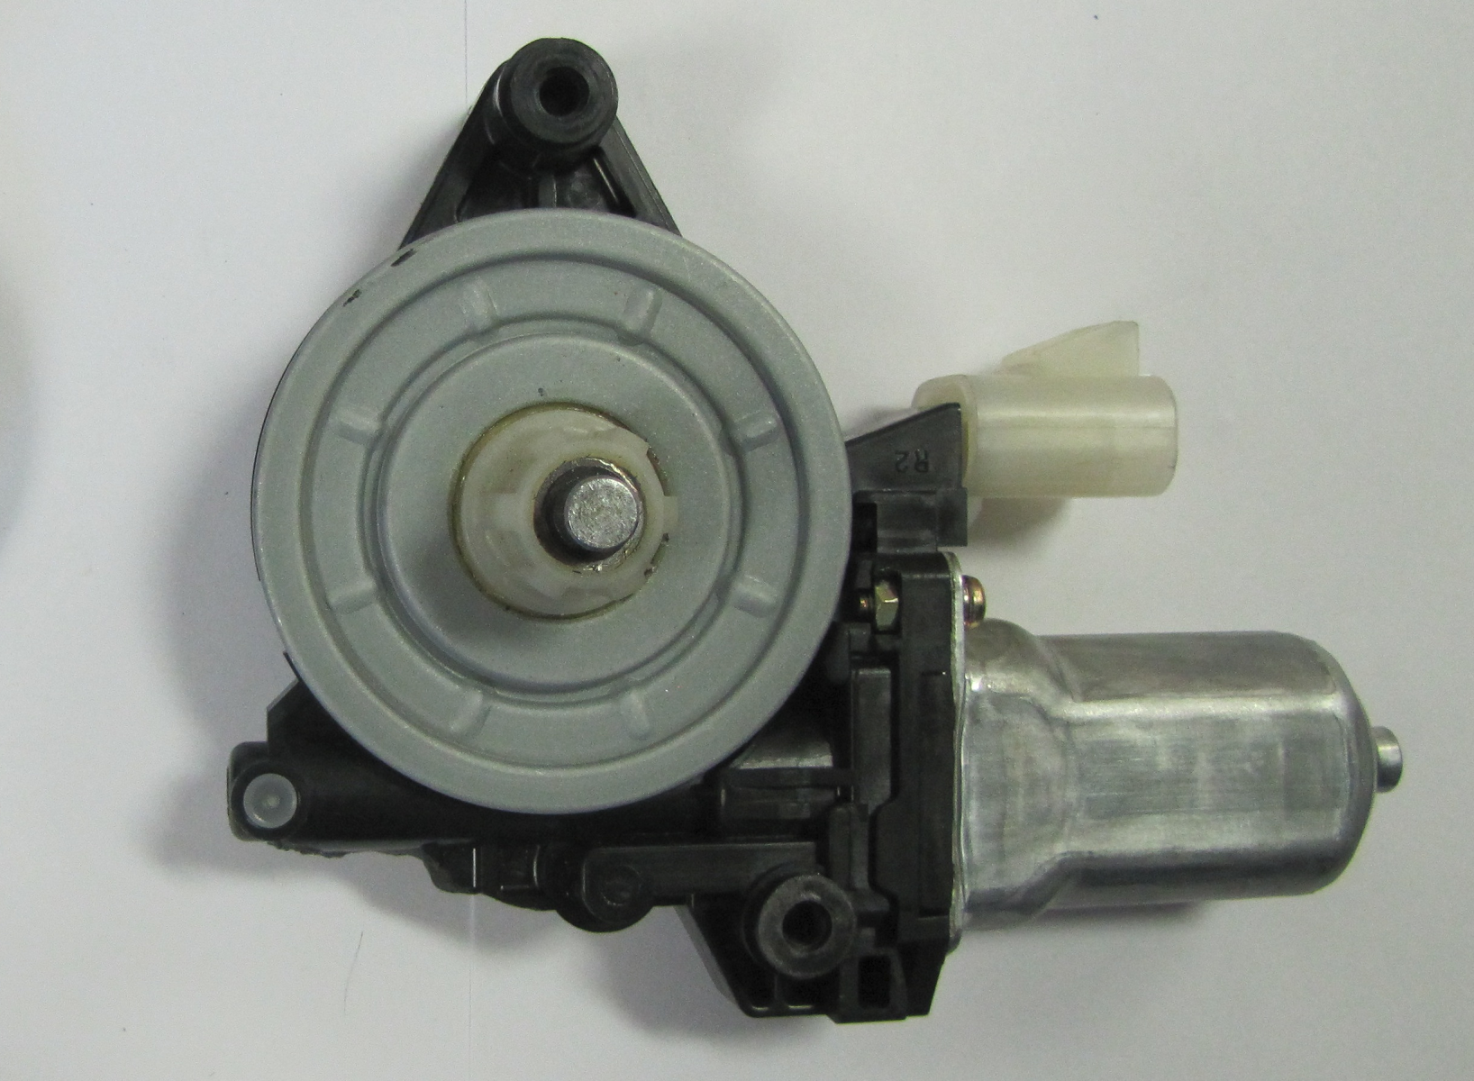
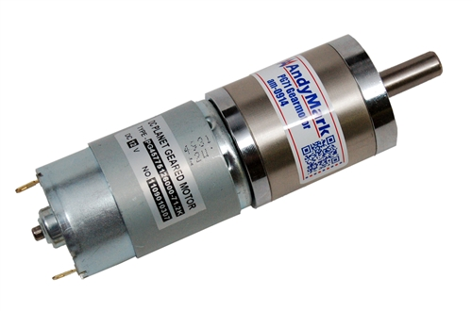
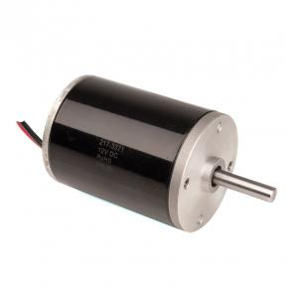
Motors, Motors, Motors
Wheels won't spin without motors.
Many types:
CIM (epic!)
mini CIM (slightly less epic)
Gear motors (slow & steady)
Window motors (slow)
We use CIMs for most drive systems

Slide 5
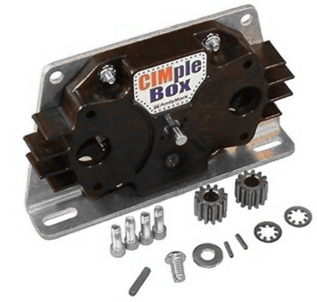
But wait MJ, how does the motor connect to the wheels?
Gears, chains or belts!
Chains are a pain.
Must add/remove links to optimize
Must add gear reduction separately (through gearbox or custom stuff)
Do allow you to power multiple wheels at once
Belts are too.
Like chains without countable things
Need to be tensioned
They slip too
Also can power multiple wheels at once
Gearboxes are clean, compact and come in many different ratios.
Can also be linear, angled, take input from multiple motors, etc.

Slide 6

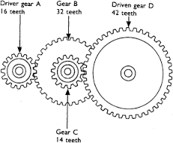
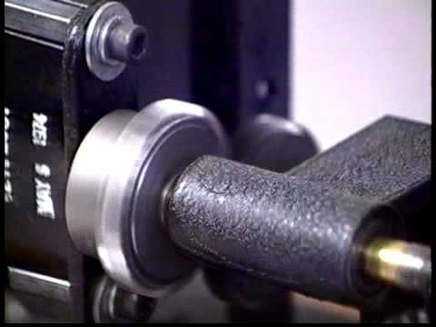
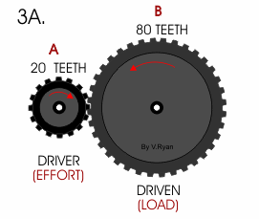
Gear Ratios!
Written as [number]:[number]
basically [turns on input shaft]:[turns on output shaft]
(teeth on output gear)/(teeth on input gear)
Torque versus Speed
Transmissions?

Slide 7
Chassis
Dear Future Me,
Draw something on the board
Sincerely,
A very tired past-self
Hint: # of wheels, torque, maneuverability, suspension (hehe), center of gravity, etc.

Slide 8

When in doubt: ctrl + c, ctrl + v
Hopefully future me has taken the liberty of acquiring some hardware to pass around.
When an interesting component reaches you, make the appropriate expression of awe as you are struck by the wonder of modern technology.
If future me has not acquired said hardware, please stand, give him a scornful glare of contempt, and silently file out of the room.
Most Importantly:
Ask Questions!

